Slide 1
CS 590 Algorithm
Chapter 8 Merge-Sort and Quick-Sort
Source: Goodrich, M. T., & Tamassia, R. (2015). Algorithm Design and Applications. Hoboken, NJ: Wiley.

Slide 2
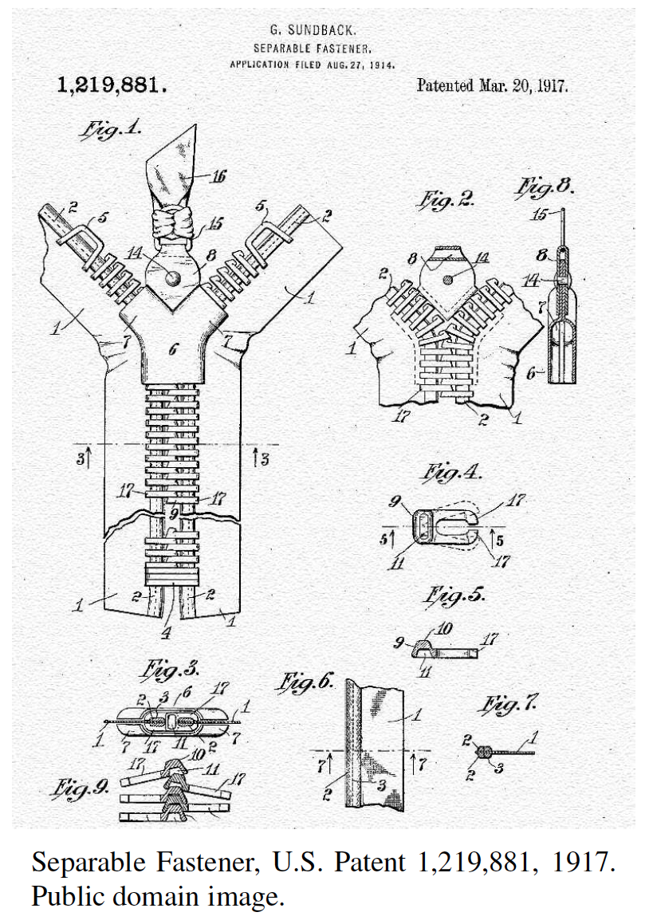
Merge-Sort & Quick-Sort
Presentation for use with the textbook, Algorithm Design and Applications, by M. T. Goodrich and R. Tamassia, Wiley, 2015

Slide 3
Application: Internet Search Engines
Sorting has a lot of applications, including uses in Internet search engines.
Sorting arises in the steps needed to build a data structure, known as the inverted file or inverted index, that allows a search engine to quickly return a list of the documents that contain a given keyword.
Word | Document Number & word location
banana | 1:3, 2:45
butterfly | 2:15, 3:12
camel | 4:40
dog | 1:60, 1:70, 2:22, 3:20, 4:11
horse | 4:21
pig | 2:55
pizza | 1:56, 3:33
Documents

Slide 4
Application: How Sorting Builds an Internet Search Engine
To build an inverted file we need to identify, for each keyword, k, the documents containing k.
Bringing all such documents together can be done simply by sorting the set of keyword-document pairs by keywords.
This places all the (k, d) pairs with the same keyword, k, right next to one another.
From this sorted list, it is then a simple computation to scan the list and build a lookup table of documents for each keyword that appears in this sorted list.
Word | Document Number & word location
banana | 1:3, 2:45
butterfly | 2:15, 3:12
camel | 4:40
dog | 1:60, 1:70, 2:22, 3:20, 4:11
horse | 4:21
pig | 2:55
pizza | 1:56, 3:33
Documents

Slide 5
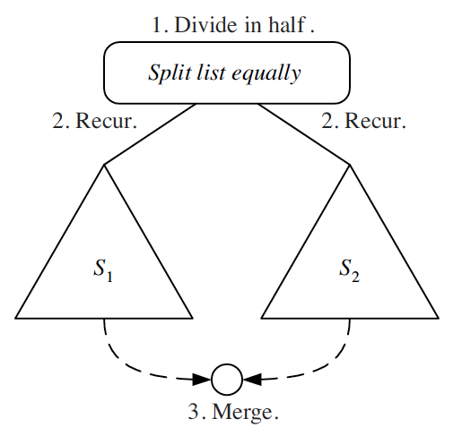
Divide-and-Conquer
Divide-and conquer is a general algorithm design paradigm:
Divide: divide the input data S in two disjoint subsets S₁ and S₂
Recur: solve the subproblems associated with S₁ and S₂
Conquer: combine the solutions for S₁ and S₂ into a solution for S
The base case for the recursion are subproblems of size 0 or 1

Slide 6
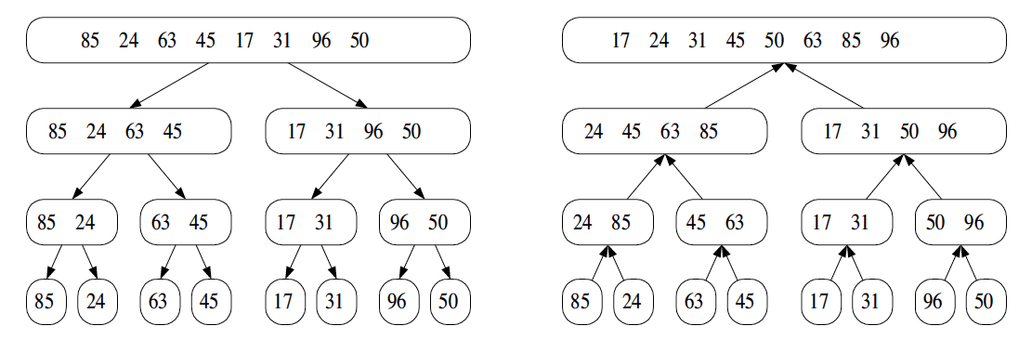
Merge-Sort
Merge-sort is a sorting algorithm based on the divide-and-conquer paradigm
Like heap-sort
It has O(n log n) running time
Unlike heap-sort
It does not use an auxiliary priority queue
It accesses data in a sequential manner (suitable to sort data on a disk)

Slide 7
The Merge-Sort Algorithm
Merge-sort on an input sequence S with n elements consists of three steps:
Divide: partition S into two sequences S₁ and S₂ of about n/2 elements each
Recur: recursively sort S₁ and S₂
Conquer: merge S₁ and S₂ into a unique sorted sequence
Algorithm mergeSort(S)
Input sequence S with n elements
Output sequence S sorted
according to C
if S.size() > 1
(S₁, S₂) ← partition(S, n/2)
mergeSort(S₁)
mergeSort(S₂)
S ← merge(S₁, S₂)

Slide 8
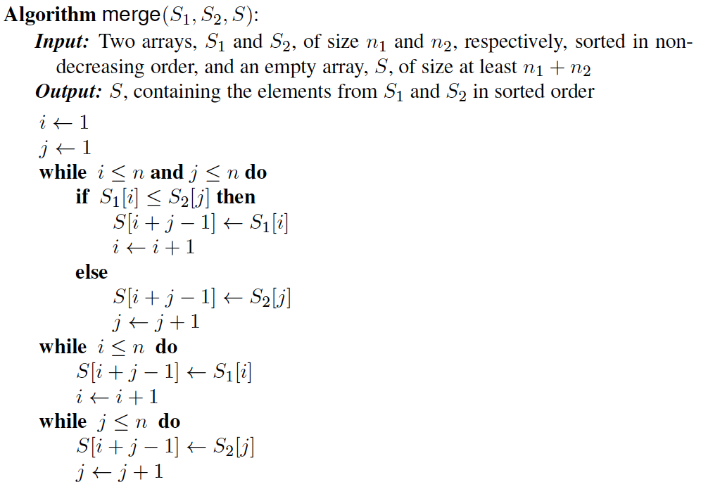
Merging Two Sorted Sequences
The conquer step of merge-sort consists of merging two sorted sequences A and B into a sorted sequence S containing the union of the elements of A and B
Merging two sorted sequences, each with n/2 elements and implemented by means of a doubly linked list, takes O(n) time

Slide 9
Merge-Sort Tree
An execution of merge-sort is depicted by a binary tree
each node represents a recursive call of merge-sort and stores
unsorted sequence before the execution and its partition
sorted sequence at the end of the execution
the root is the initial call
the leaves are calls on subsequences of size 0 or 1
7 2 ⏐ 9 4 → 2 4 7 9
7 ⏐ 2 → 2 7
9 ⏐ 4 → 4 9
7 → 7
2 → 2
9 → 9
4 → 4

Slide 10
Execution Example
Partition
7 2 9 4 ⏐ 3 8 6 1 → 1 2 3 4 6 7 8 9
7 2 9 4 → 2 4 7 9
3 8 6 1 → 1 3 8 6
7 2 → 2 7
9 4 → 4 9
3 8 → 3 8
6 1 → 1 6
7 → 7
2 → 2
9 → 9
4 → 4
3 → 3
8 → 8
6 → 6
1 → 1

Slide 11
Execution Example (cont.)
Recursive call, partition
7 2 9 4 ⏐ 3 8 6 1 → 1 2 3 4 6 7 8 9
7 2 ⏐ 9 4 → 2 4 7 9
3 8 6 1 → 1 3 8 6
7 2 → 2 7
9 4 → 4 9
3 8 → 3 8
6 1 → 1 6
7 → 7
2 → 2
9 → 9
4 → 4
3 → 3
8 → 8
6 → 6
1 → 1

Slide 12
Execution Example (cont.)
Recursive call, partition
7 2 9 4 ⏐ 3 8 6 1 → 1 2 3 4 6 7 8 9
7 2 ⏐ 9 4 → 2 4 7 9
3 8 6 1 → 1 3 8 6
7 ⏐ 2 → 2 7
9 4 → 4 9
3 8 → 3 8
6 1 → 1 6
7 → 7
2 → 2
9 → 9
4 → 4
3 → 3
8 → 8
6 → 6
1 → 1

Slide 13
Execution Example (cont.)
Recursive call, base case
7 2 9 4 ⏐ 3 8 6 1 → 1 2 3 4 6 7 8 9
7 2 ⏐ 9 4 → 2 4 7 9
3 8 6 1 → 1 3 8 6
7 ⏐ 2 → 2 7
9 4 → 4 9
3 8 → 3 8
6 1 → 1 6
7 → 7
2 → 2
9 → 9
4 → 4
3 → 3
8 → 8
6 → 6
1 → 1

Slide 14
Execution Example (cont.)
Recursive call, base case
7 2 9 4 ⏐ 3 8 6 1 → 1 2 3 4 6 7 8 9
7 2 ⏐ 9 4 → 2 4 7 9
3 8 6 1 → 1 3 8 6
7 ⏐ 2 → 2 7
9 4 → 4 9
3 8 → 3 8
6 1 → 1 6
7 → 7
2 → 2
9 → 9
4 → 4
3 → 3
8 → 8
6 → 6
1 → 1

Slide 15
Execution Example (cont.)
Merge
7 2 9 4 ⏐ 3 8 6 1 → 1 2 3 4 6 7 8 9
7 2 ⏐ 9 4 → 2 4 7 9
3 8 6 1 → 1 3 8 6
7 ⏐ 2 → 2 7
9 4 → 4 9
3 8 → 3 8
6 1 → 1 6
7 → 7
2 → 2
9 → 9
4 → 4
3 → 3
8 → 8
6 → 6
1 → 1

Slide 16
Execution Example (cont.)
Recursive call, …, base case, merge
7 2 9 4 ⏐ 3 8 6 1 → 1 2 3 4 6 7 8 9
7 2 ⏐ 9 4 → 2 4 7 9
3 8 6 1 → 1 3 8 6
7 ⏐ 2 → 2 7
9 4 → 4 9
3 8 → 3 8
6 1 → 1 6
7 → 7
2 → 2
9 → 9
4 → 4
3 → 3
8 → 8
6 → 6
1 → 1

Slide 17
Execution Example (cont.)
Merge
7 2 9 4 ⏐ 3 8 6 1 → 1 2 3 4 6 7 8 9
7 2 ⏐ 9 4 → 2 4 7 9
3 8 6 1 → 1 3 8 6
7 ⏐ 2 → 2 7
9 4 → 4 9
3 8 → 3 8
6 1 → 1 6
7 → 7
2 → 2
9 → 9
4 → 4
3 → 3
8 → 8
6 → 6
1 → 1

Slide 18
Execution Example (cont.)
Recursive call, …, merge, merge
7 2 9 4 ⏐ 3 8 6 1 → 1 2 3 4 6 7 8 9
7 2 ⏐ 9 4 → 2 4 7 9
3 8 6 1 → 1 3 6 8
7 ⏐ 2 → 2 7
9 4 → 4 9
3 8 → 3 8
6 1 → 1 6
7 → 7
2 → 2
9 → 9
4 → 4
3 → 3
8 → 8
6 → 6
1 → 1

Slide 19
Execution Example (cont.)
Merge
7 2 9 4 ⏐ 3 8 6 1 → 1 2 3 4 6 7 8 9
7 2 ⏐ 9 4 → 2 4 7 9
3 8 6 1 → 1 3 6 8
7 ⏐ 2 → 2 7
9 4 → 4 9
3 8 → 3 8
6 1 → 1 6
7 → 7
2 → 2
9 → 9
4 → 4
3 → 3
8 → 8
6 → 6
1 → 1

Slide 20
Analysis of Merge-Sort
The height h of the merge-sort tree is O(log n)
at each recursive call we divide in half the sequence,
The overall amount or work done at the nodes of depth i is O(n)
we partition and merge 2^{i} sequences of size n/2^{i}
we make 2^{i+1} recursive calls
Thus, the total running time of merge-sort is O(n log n)
depth | #seqs | size
0 | 1 | n
1 | 2 | n/2
i | 2^{i} | n/2^{i}
… | … | …

Slide 21
Summary of Sorting Algorithms
Algorithm | Time | Notes
selection-sort | O(n²) | slow in-place for small data sets (< 1K)
insertion-sort | O(n²) | slow in-place for small data sets (< 1K)
heap-sort | O(n log n) | fast in-place for large data sets (1K — 1M)
merge-sort | O(n log n) | fast sequential data access for huge data sets (> 1M)

Slide 22
Quick-Sort
Presentation for use with the textbook, Algorithm Design and Applications, by M. T. Goodrich and R. Tamassia, Wiley, 2015
7 4 9 6 2 → 2 4 6 7 9
4 2 → 2 4
7 9 → 7 9
2 → 2
9 → 9

Slide 23
Quick-Sort
Quick-sort is a randomized sorting algorithm based on the divide-and-conquer paradigm:
Divide: pick a random element x (called pivot) and partition S into
L elements less than x
E elements equal x
G elements greater than x
Recur: sort L and G
Conquer: join L, E and G
x
x
L
G
E
x

Slide 24
Partition
We partition an input sequence as follows:
We remove, in turn, each element y from S and
We insert y into L, E or G, depending on the result of the comparison with the pivot x
Each insertion and removal is at the beginning or at the end of a sequence, and hence takes O(1) time
Thus, the partition step of quick-sort takes O(n) time
Algorithm partition(S, p)
Input sequence S, position p of pivot
Output subsequences L, E, G of the elements of S less than, equal to, or greater than the pivot, resp.
L, E, G ← empty sequences
x ← S.remove(p)
while ¬S.isEmpty()
y ← S.remove(S.first())
if y < x
L.addLast(y)
else if y = x
E.addLast(y)
else { y > x }
G.addLast(y)
return L, E, G

Slide 25
Quick-Sort Tree
An execution of quick-sort is depicted by a binary tree
Each node represents a recursive call of quick-sort and stores
Unsorted sequence before the execution and its pivot
Sorted sequence at the end of the execution
The root is the initial call
The leaves are calls on subsequences of size 0 or 1
7 4 9 6 2 → 2 4 6 7 9
4 2 → 2 4
7 9 → 7 9
2 → 2
9 → 9

Slide 26
Execution Example
Pivot selection
7 2 9 4 3 7 6 1 → 1 2 3 4 6 7 8 9
7 2 9 4 → 2 4 7 9
3 8 6 1 → 1 3 8 6
2 → 2
9 4 → 4 9
3 → 3
8 → 8
9 → 9
4 → 4

Slide 27
Execution Example (cont.)
Partition, recursive call, pivot selection
7 2 9 4 3 7 6 1 → 1 2 3 4 6 7 8 9
2 4 3 1 → 2 4 7 9
3 8 6 1 → 1 3 8 6
2 → 2
9 4 → 4 9
3 → 3
8 → 8
9 → 9
4 → 4

Slide 28
Execution Example (cont.)
Partition, recursive call, base case
7 2 9 4 3 7 6 1 → → 1 2 3 4 6 7 8 9
2 4 3 1 →→ 2 4 7
3 8 6 1 → 1 3 8 6
1 → 1
9 4 → 4 9
3 → 3
8 → 8
9 → 9
4 → 4

Slide 29
Execution Example (cont.)
Recursive call, …, base case, join
7 2 9 4 3 7 6 1 → 1 2 3 4 6 7 8 9
2 4 3 1 → 1 2 3 4
3 8 6 1 → 1 3 8 6
1 → 1
4 3 → 3 4
3 → 3
8 → 8
9 → 9
4 → 4

Slide 30
Execution Example (cont.)
Recursive call, pivot selection
7 2 9 4 3 7 6 1 → 1 2 3 4 6 7 8 9
2 4 3 1 → 1 2 3 4
7 9 7 1 → 1 3 8 6
1 → 1
4 3 → 3 4
8 → 8
9 → 9
9 → 9
4 → 4

Slide 31
Execution Example (cont.)
Partition, …, recursive call, base case
7 2 9 4 3 7 6 1 → 1 2 3 4 6 7 8 9
2 4 3 1 → 1 2 3 4
7 9 7 1 → 1 3 8 6
1 → 1
4 3 → 3 4
8 → 8
9 → 9
9 → 9
4 → 4

Slide 32
Execution Example (cont.)
Join, join
7 2 9 4 3 7 6 1 → 1 2 3 4 6 7 7 9
2 4 3 1 → 1 2 3 4
7 9 7 → 17 7 9
1 → 1
4 3 → 3 4
8 → 8
9 → 9
9 → 9
4 → 4

Slide 33
Worst-case Running Time
The worst case for quick-sort occurs when the pivot is the unique minimum or maximum element
One of L and G has size n − 1 and the other has size 0
The running time is proportional to the sum
n + (n − 1) + … + 2 + 1
Thus, the worst-case running time of quick-sort is O(n²)
depth | time
0 | n
1 | n − 1
… | …
n − 1 | 1
…

Slide 34
Expected Running Time
Consider a recursive call of quick-sort on a sequence of size s
Good call: the sizes of L and G are each less than 3s/4
Bad call: one of L and G has size greater than 3s/4
A call is good with probability 1/2
1/2 of the possible pivots cause good calls:
7 2 9 4 3 7 6 1 9
7 2 9 4 3 7 6 1
2 4 3 1
7 9 7 1 → 1
1
7 2 9 4 3 7 6
Good call
Bad call
1 2 3 4 5 6 7 8 9 10 11 12 13 14 15 16
Bad pivots
Good pivots
Bad pivots

Slide 35
Expected Running Time, Part 2
Probabilistic Fact: The expected number of coin tosses required in order to get k heads is 2k
For a node of depth i, we expect
i/2 ancestors are good calls
The size of the input sequence for the current call is at most (3/4)^{i/2}n
Therefore, we have
For a node of depth 2log_{4/3}n, the expected input size is one
The expected height of the quick-sort tree is O(log n)
The amount or work done at the nodes of the same depth is O(n)
Thus, the expected running time of quick-sort is O(n log n)

Slide 36
In-Place Quick-Sort
Quick-sort can be implemented to run in-place
In the partition step, we use replace operations to rearrange the elements of the input sequence such that
the elements less than the pivot have rank less than h
the elements equal to the pivot have rank between h and k
the elements greater than the pivot have rank greater than k
The recursive calls consider
elements with rank less than h
elements with rank greater than k
See inPlacePartition(S, a, b) P.255
Algorithm inPlaceQuickSort(S, l, r)
Input sequence S, ranks l and r
Output sequence S with the elements of rank between l and r rearranged in increasing order
if l ≥ r
return
i ← a random integer between l and r
x ← S.elemAtRank(i)
(h, k) ← inPlacePartition(x)
inPlaceQuickSort(S, l, h − 1)
inPlaceQuickSort(S, k + 1, r)

Slide 37
In-Place Partitioning
Perform the partition using two indices to split S into L and E U G (a similar method can split E U G into E and G).
Repeat until j and k cross:
Scan j to the right until finding an element > x.
Scan k to the left until finding an element < x.
Swap elements at indices j and k
j
k
3 2 5 1 0 7 3 5 9 2 7 9 8 9 7 6 9
(pivot = 6)
j
k
3 2 5 1 0 7 3 5 9 2 7 9 8 9 7 6 9

Slide 38
Summary of Sorting Algorithms
Algorithm | Time | Notes
selection-sort | O(n²) | in-place slow (good for small inputs)
insertion-sort | O(n²) | in-place slow (good for small inputs)
quick-sort | O(n log n) expected | in-place, randomized fastest (good for large inputs)
heap-sort | O(n log n) | in-place fast (good for large inputs)
merge-sort | O(n log n) | sequential data access fast (good for huge inputs)

Slide 39
Sorting Lower Bound
Presentation for use with the textbook, Algorithm Design and Applications, by M. T. Goodrich and R. Tamassia, Wiley, 2015

Slide 40
Comparison-Based Sorting
Many sorting algorithms are comparison based.
They sort by making comparisons between pairs of objects
Examples: bubble-sort, selection-sort, insertion-sort, heap-sort, merge-sort, quick-sort, ...
Let us therefore derive a lower bound on the running time of any algorithm that uses comparisons to sort n elements, x₁, x₂, …, x_{n}.
Is x_{i} < x_{j}?
no
yes

Slide 41
Counting Comparisons
Let us just count comparisons then.
Each possible run of the algorithm corresponds to a root-to-leaf path in a decision tree

Slide 42
Decision Tree Height
The height of the decision tree is a lower bound on the running time
Every input permutation must lead to a separate leaf output
If not, some input …4…5… would have same output ordering as …5…4…, which would be wrong
Since there are n!=1⋅2 ⋅ … ⋅n leaves, the height is at least log (n!)

Slide 43
The Lower Bound
Any comparison-based sorting algorithms takes at least log (n!) time
Therefore, any such algorithm takes time at least
That is, any comparison-based sorting algorithm must run in Ω(n log n) time.

Slide 44
About Stevens
A premier, private research university with a mission to inspire, nurture and educate leaders in tomorrow’s technology-centric environment while contributing to the solution of the most challenging problems of our time

